Slide 1

Cross Chain NFT Paymaster
Tom Lin, Full Stack Developer

Slide 2

Hedera ♾️ Ethereum
- Low-cost, efficient NFT minting on Hedera powered by Hedera Token Service
- Cross-chain ownership proof is generated on Hedera as an ECDSA Signature
- Uses ERC-4337 Account Abstraction to encode signature information in User Operation for Paymaster verification
- Gas sponsorship includes cost of automation wallet creation and all transaction fees

Slide 3
DEMO

Slide 4
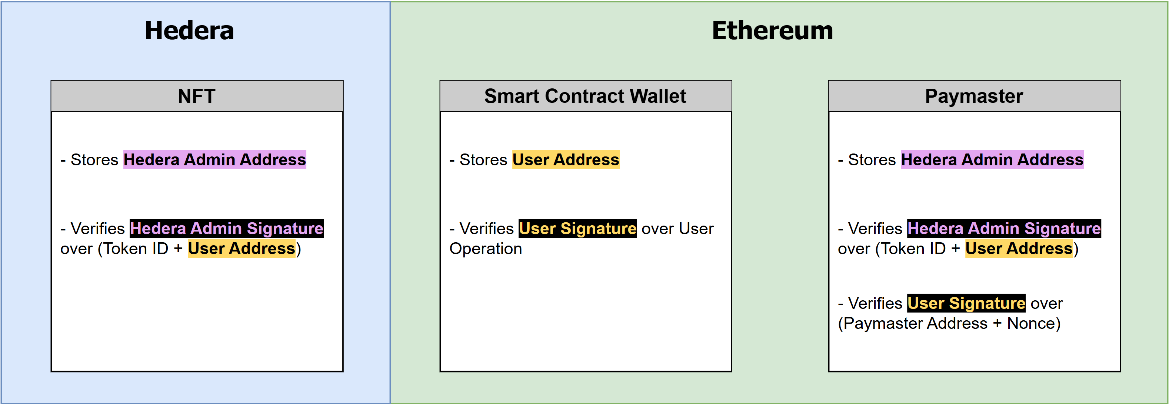
How It Works
Paymaster uses same User Address when verifying User Signature and Hedera Admin Signature
=> Verified NFT owner on Hedera is the same user transacting on Ethereum

Slide 5

Thank you
Enjoy README for more info
https://github.com/FlyGuy352/CrossChainNFTPaymaster

